Slide 1
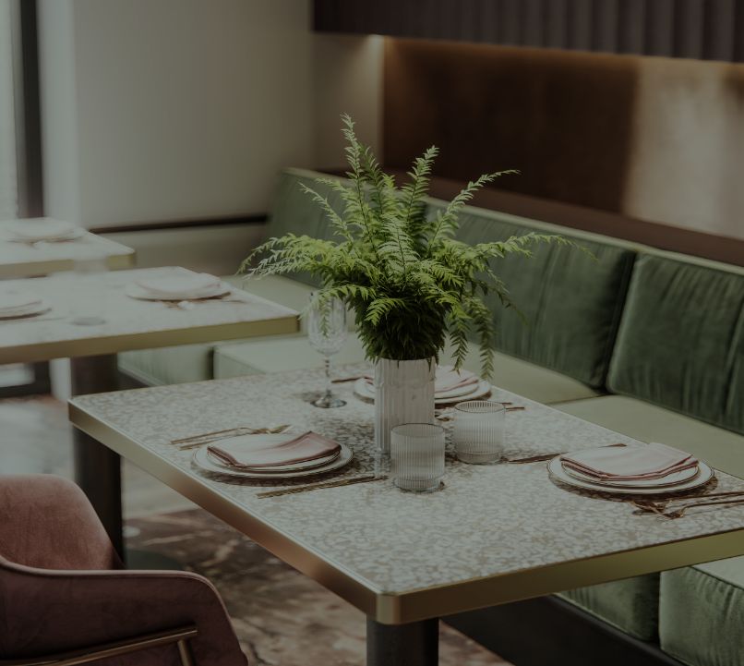
Restaurant Orders
Pitch

Slide 2
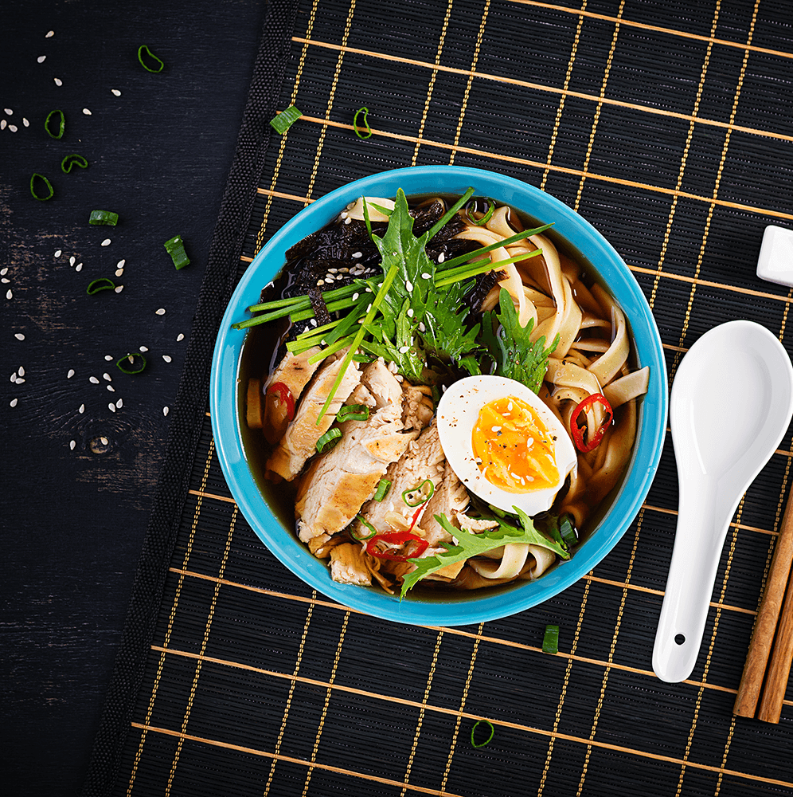
About us
A quarter's worth of orders from a fictitious restaurant serving international cuisine, including the date and time of each order, the items ordered, and additional details on the type, name and price of the items.
About
2

Slide 3
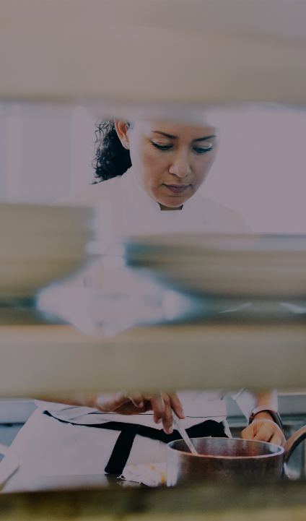
Recommended Analysis
What were the least and most ordered items? What categories were they in?
What do the highest spend orders look like? Which items did they buy and how much did they spend?
Were there certain times that had more or less orders?
Which cuisines should we focus on developing more menu items for based on the data?

Slide 4
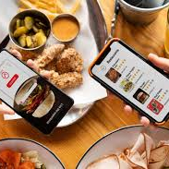
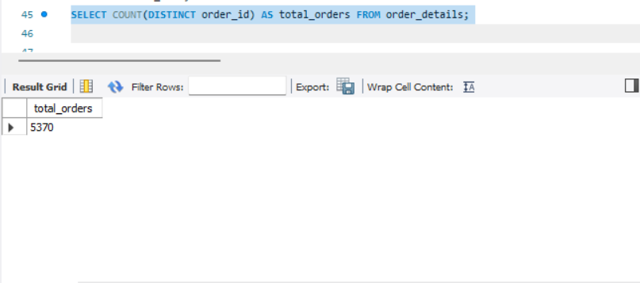
What is the total number of orders placed?

Slide 5
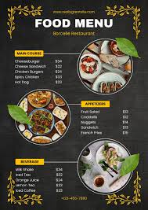
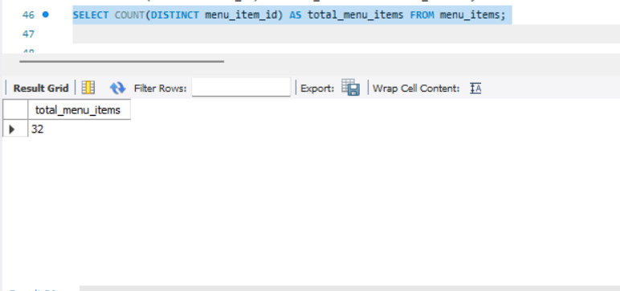
What is the total number of unique items on the menu?

Slide 6
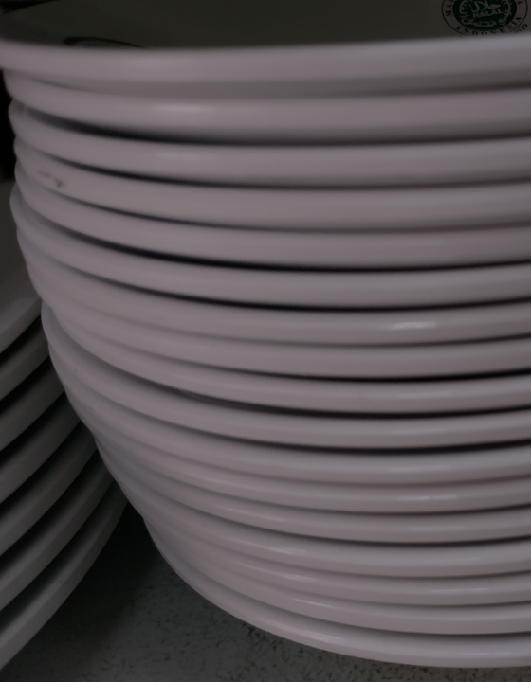
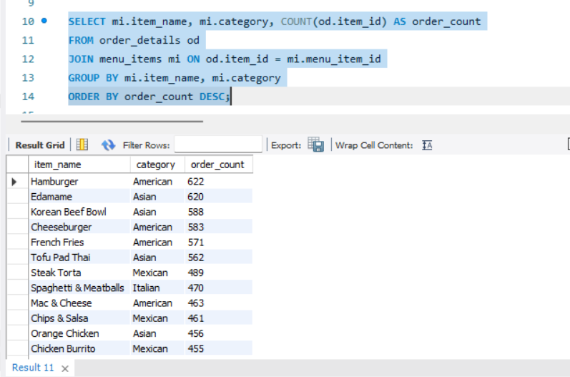
What are the most and least ordered items?

Slide 7
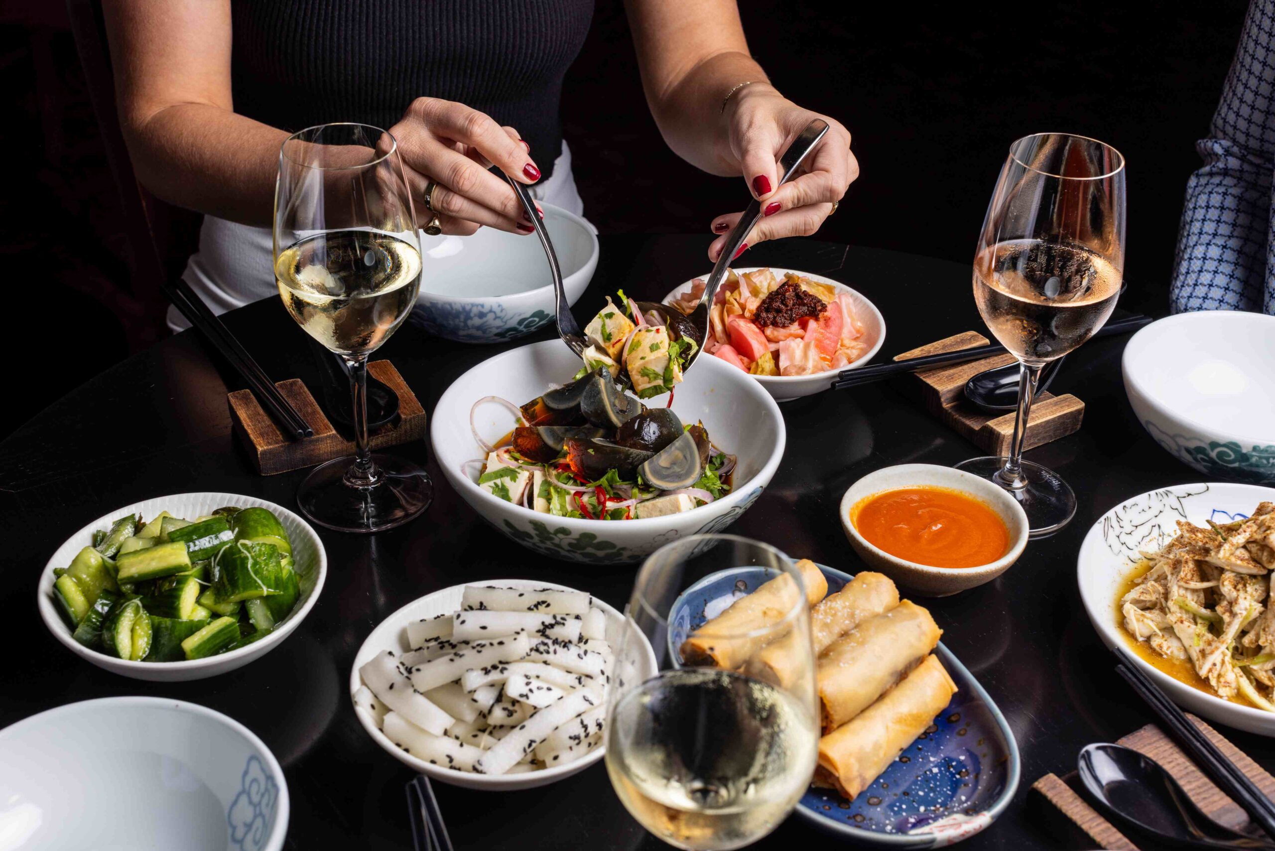
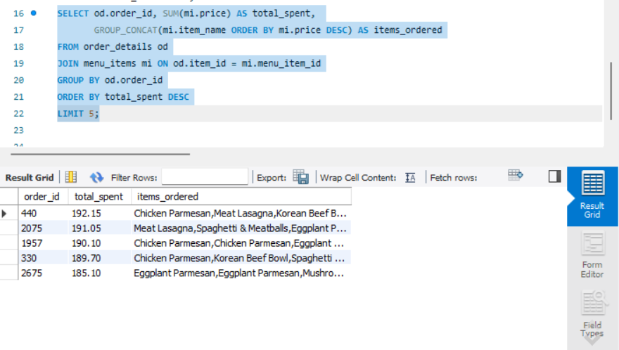
What do the TOP 5 spending orders
Company

Slide 8
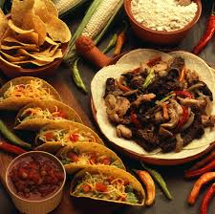
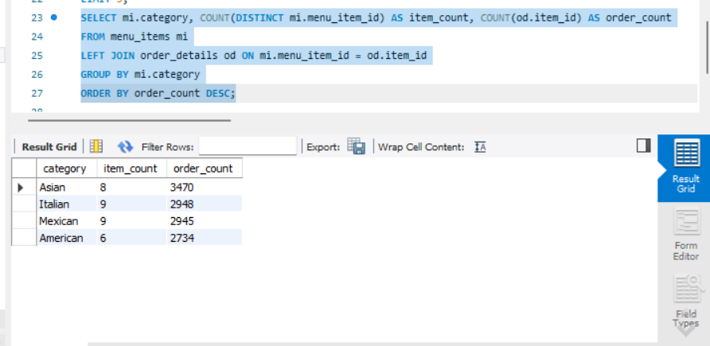
Which cuisines should we focus on developing more menu items for?
research​
We based our research on market trends and data from over 1,000 restaurants​
abstract
We believe managers need new industry tools to help run their restaurants​
Business
design
Identifies cuisines that are frequently ordered but may have fewer menu options.​

Slide 9
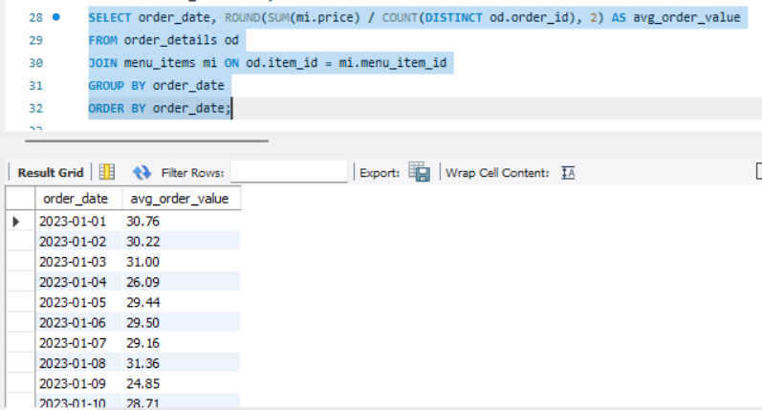
Market overview
Market
What is the average order value per day?
​
$3B
$2b
$1b
Freedom to invent​
Selectively inclusive market​
Serviceable available market​
Shows average order value for each day, helping to track customer spending trends.​

Slide 10
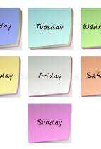
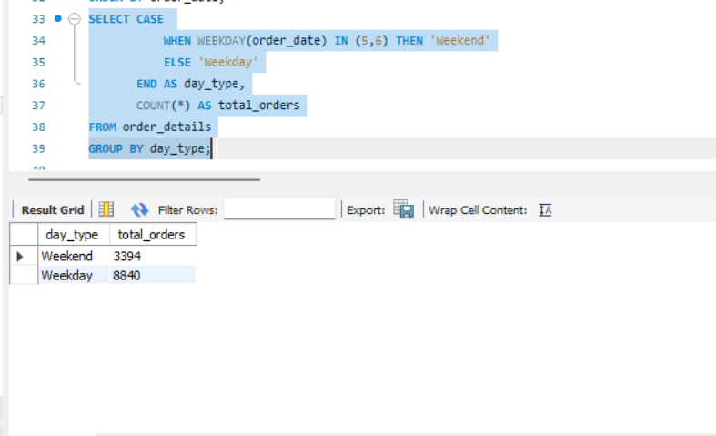
How does order volume change on weekends vs. weekdays
Determines if more orders occur on weekends or weekdays.

Slide 11

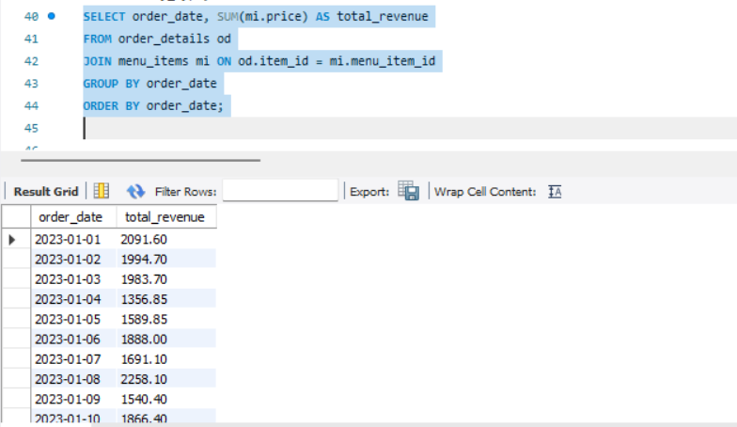
What is the trend in total revenue over the quarter?
Helps track daily revenue trends over the quarter.

